Slide 1
Impact of Population Change on Housing and Rental Price During COVID
Sarah H Lee, Stella Kim, Pankaj Parashar, and Sydney Harkins

Slide 2
Setting the Foundation: Inspiration and Data Resources
COVID-19 Has Changed the Housing Market Forever. Here’s Where Americans Are Moving (And Why)
We were inspired to conduct this research into the housing market after reading the Forbes article listed above that discusses COVID-19’s impact on the housing market. Because we are in such a significant setting, we wanted to see what things are like with the ‘new pandemic normal’. There’s currently a lot of movement and change, and we wanted to look at how that affected the housing market specifically.
For our data analysis, we wanted to look at population changes spanning from 2018-2020 as well as housing and rental prices and how they have changed during the same time span.
Notes:
Set the foundation with the initial article that inspired the research and then also include where we got the data from.
Wanted to see what things are like with the ‘new pandemic normal’, there’s a lot of movement and change as a result of COVID.
Raw data from Zillow
-Rental data - smoothed, seasonally adjusted
-Housing data - All homes SFR, Condo/CO-Op smoothed seasonally adjusted
-Also obtained lat/lng from Google API for heatmap

Slide 3
Questions to Answer
Which cities across the United States experienced population changes due to COVID?
How has the rate of housing price changed between the two periods (2018-2019) and (2019-2020)?
Is there a correlation between the population change rate and the housing market price rate?
How has the rate of rental prices changed throughout 2018 to 2020 in certain metropolitan areas due to COVID?

Slide 4
Data Source
Zillow January 2018 - September 2020
2019 Census Population Data
2020 World Population Review
Google API Request from Gmaps (for heatmap)
Notes:
Raw data from Zillow
-Rental data - smoothed, seasonally adjusted
-Housing data - All homes SFR, Condo/CO-Op smoothed seasonally adjusted
-Also obtained lat/lng from Google API for heatmap
On the world population view website, the 200 largest cities in the US by population 2020 were introduced. They don’t mention how specifically they collected or calculated the 2020 population, but they said their data is based on the Census data.
Housing prices - chose the data set that has all house types, including a condo. This data is already processed and adjusted by Zillow, reflecting the typical value for homes in the 35th to 65th percentile range.
Rental prices -. This data set has processed rental prices falling into 40th to 60th percentile range.
So we collected data sets to answer the questions we had.
For the housing and rental prices, we obtained data from Zillow.com, and for the population data, we obtained 2018 and 2019 population from the US census website and 2019 from worldpopulationview.come

Slide 5
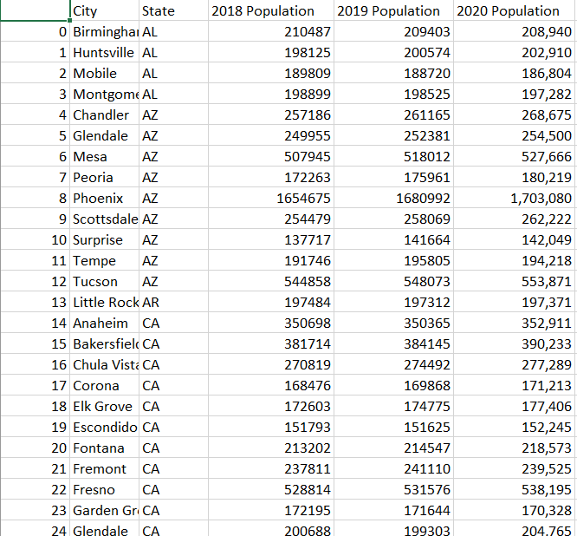
Cleanup Process
Population data cleanup
Population 2018, 2019 and 2020 merged for common cities.
Renamed columns using pandas.
Housing data cleanup
Isolated only data from 2018 and forward
Dropped city records with null values
Reset indexes
Rental data cleanup
Isolated only data from 2018 and forward
Merged rental and population for common cities
Notes:
Once we collected the datasets we need, we started cleaning up the datasets.
For the population data sets from the US census had more than 1000 cities while 2020 population data had 200 cities, we pulled out the common cities in all population data. Then we merged them into one dataframe based on the common cities. After that, we abbreviated the full state names and exported the data frame as a CSV file.
For the housing and rental dataset, we dropped city records with null values. Then we isolated data from 2018 and forward and sorted them out based on the common cities we had for population data. After resetting indexes, we created data frames for each year and exported them as CSV files.

Slide 6
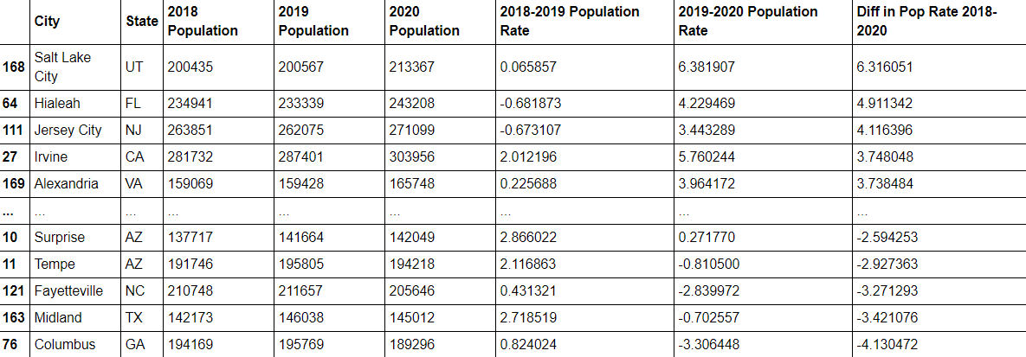
Analysis of Population Change
Notes:
To begin the analysis of population change during the COVID period, we examined the population in 2018, 2019 and 2020 (COVID era). We accounted for growth or decline in population by calculating the change in percentage from 2018-2019 and 2019-2020 as reported by the U.S. Census. Further, we found the difference between the two time periods to derive which cities had the largest growth or decline from 2018 to 2020.

Slide 7
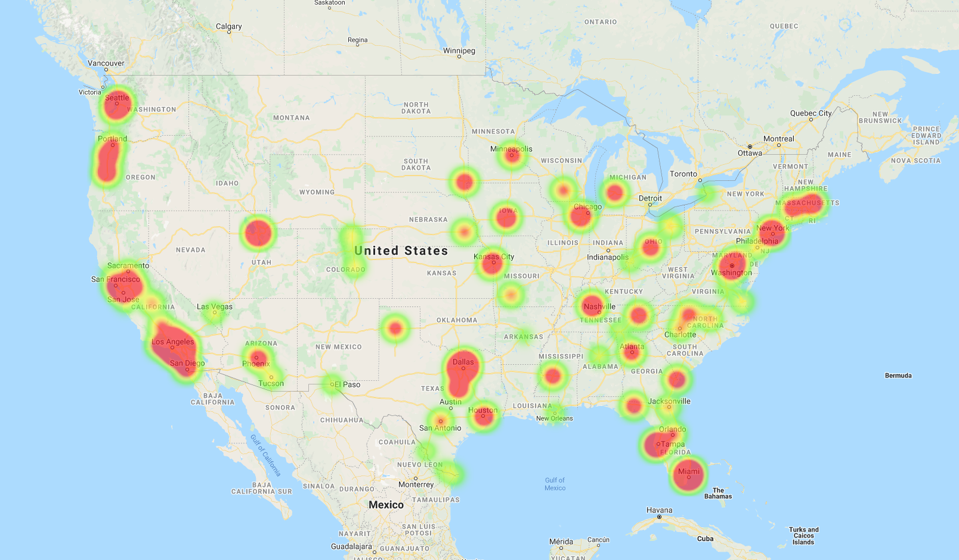
Cities with Positive Population Growth Rate 2018-2020
Atlanta, GA
Notes:
We took the cities with positive growth rate and created a heat map to show which cities people were moving into thus had higher demand. Would expect the coastal towns to have most activity but can see that movement is also present inland/midwest regions.

Slide 8
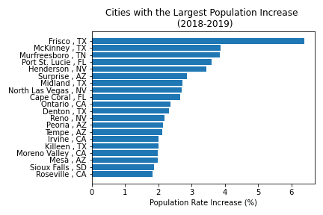
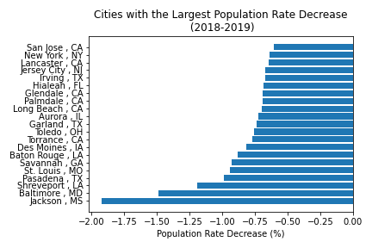


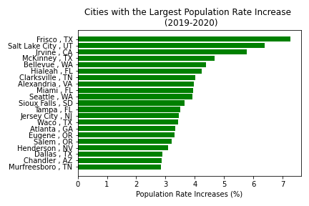
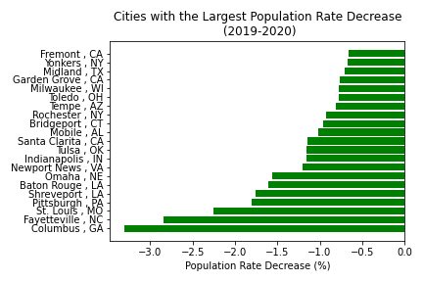
Which Cities Experienced Population Changes Due to COVID?
Notes:
We narrowed the list to the top 20 cities with the highest and lowest population rate change during each time period (2018-2019 and 2019-2020) . Many cities overlap in the bar graphs such as Frisco, TX (blue arrow) continues to maintain the highest population rate in each period. Hialeah, FL (red arrow) which was initially among the bottom 20 in 2018-2019 and then moved way up to the top 20 cities with largest population rate in 2019-2020.

Slide 9
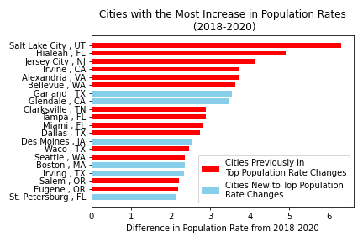
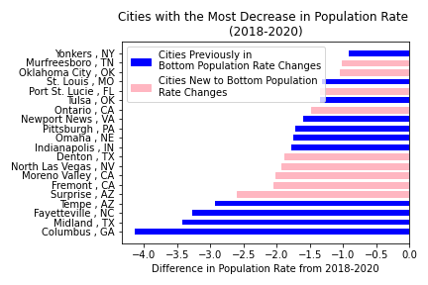
Highest and Lowest Demand Cities
Overlap of cities with previous years
6 new cities with higher demand
9 new cities with declining demand
Notes:
In the overall period of 2018-2020, we see Salt Lake City experiencing the highest population growth rate and Columbus, GA with the highest decline. In comparison to the cities that made it to the top and bottom 20 lists in the previous slide, six new cities in light blue (i.e. Garland TX, Glendale CA, Des Moines IA, Boston MA, Irving TX, and St Petersburg FL) appear. From this, it can be deduced that these cities were most affected by the pandemic in 2020 in drawing new residents. On the other hand, cities such as Surprise AZ, Moreno Valley CA, and Fremont CA (light pink) had a larger growth decline rate when comparing pre-COVID to COVID periods, which reflects that residents were leaving these cities at a faster rate in 2020.

Slide 10
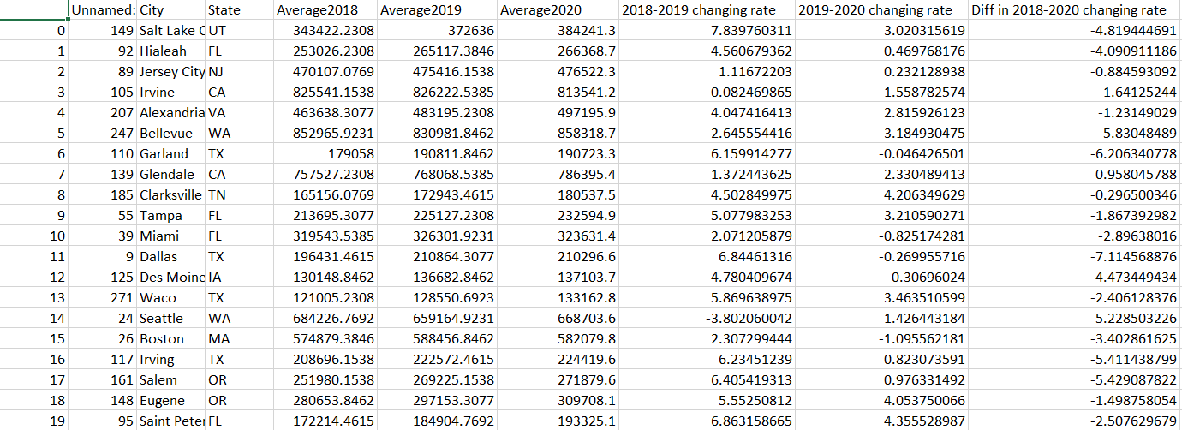
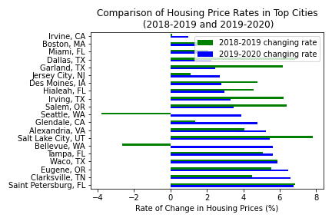
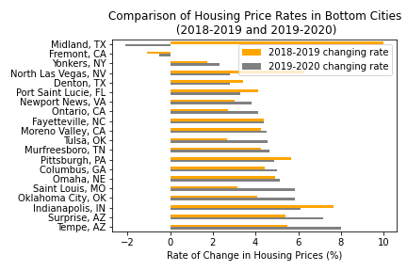
How Has Housing Rate Changed in the Cities with Highest/Lowest Demand?
Notes:
We collected housing sales price data for 2018-2020 and plotted the rate of change for each year sorted for the top and bottom twenty cities from the population data.
Of note, Seattle and Bellevue in Washington previously had a decrease in their housing sales price in 2018 to 2019 but have had a jump in their pricing from 2019 to 2020. This huge increase in rate could be a byproduct of the pandemic with residents purchasing homes that support their telecommuting arrangements in the setting of low interest rates, which make home ownership affordable and desirable. In comparing the 2018-2019 housing price rate with 2019-2020, most cities with high population growth rate have experienced an increase in housing prices. However, cities with declining population rates have inversely been stagnant or lost valuation in their housing prices.

Slide 11
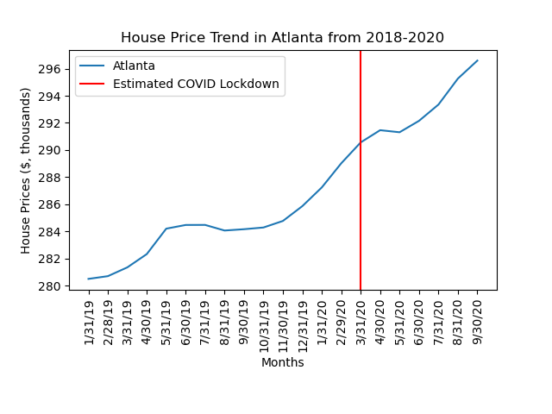
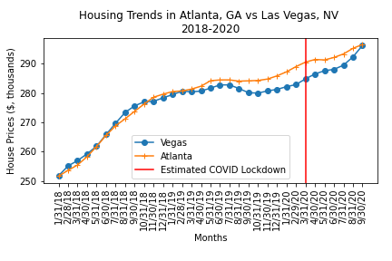
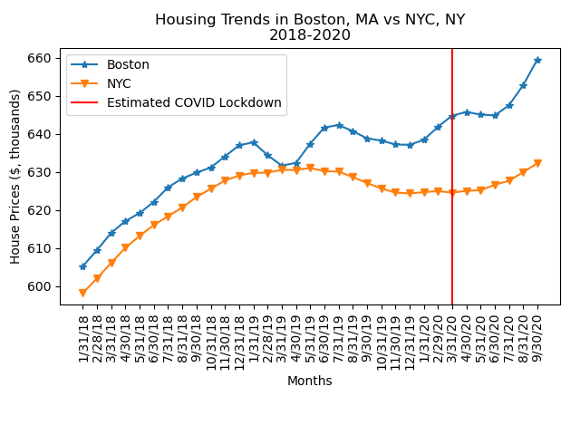
We looked more closely at cities of particular interest to us to see if we could more easily identify a trend in the data. As shown in the trendline between Atlanta and Las Vegas, housing prices did increase before the estimated COVID lockdown, but they continued to increase even after that time period with no shown decrease.
With Boston and NYC, there is also a clear increase after the COVID lockdowns began, with only Boston showing increases before that period.
Notes:
We also plotted Atlanta, GA housing price trends over the past 2 years and saw that there was a stagnation of housing prices during the initial COVID lockdown period. It can be assumed that buyers were hesitant to view prospective homes to purchase due to fear of contracting COVID. However, around about May 2020, Atlanta sees a surge in housing prices which may be due to Georgia’s reopening and historically low interest rates.
In comparing Atlanta to a comparable housing market, such as Las Vegas, NV, we see similar housing trends pre and post COVID; although, Las Vegas saw a larger decline in the housing market prior to COVID.
We further examined the housing trends in a higher priced housing market, specifically NYC and Boston, where similar patterns emerged. It is interesting to note that NYC has had a slower recovery since COVID lockdown possibly due being severely impacted by the cases of COVID which led to a prolonged lockdown period.

Slide 12
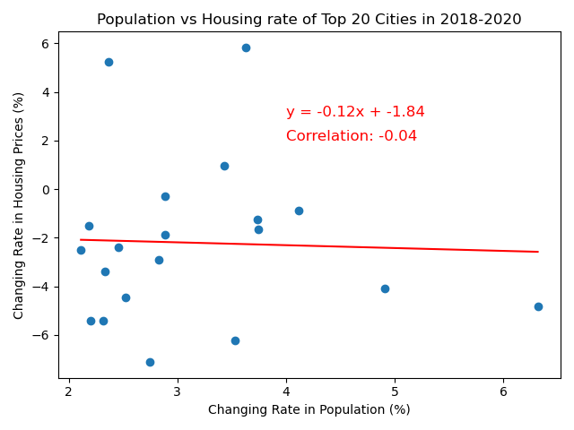
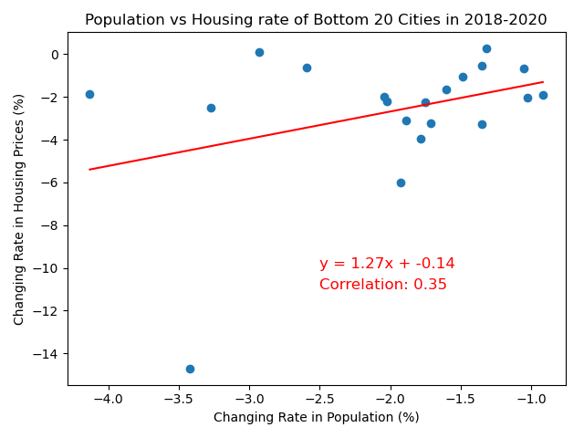
Does a Correlation Exist Between Population Change Rate and Housing Market Price Rate?
Notes:
To look for a correlation between the population vs housing market rate, we continued analyzing the top and bottom 20 cities with the largest population changes against their housing market changes. Our theory was to see a strong correlation between changes in population on the housing market. We plotted population vs housing market rate changes from 2018 to 2020 for the top 20 cities, there is actually a slight negative rate of change (i.e. as a city grows in population, the housing prices see a small decrease in pricing.) Bottom 20 cities reflected a decrease in housing price rates in relation to a larger decline in population rate. This plot shows that the demand in houses decreased when more residents moved to other cities, thus lowering the housing prices. Contrary, there is no correlation for the top 20 cities. This analysis may be limited/not reflective due to a low amount of census data in 2020, which likely inhibited sufficient comparison to the housing data.

Slide 13
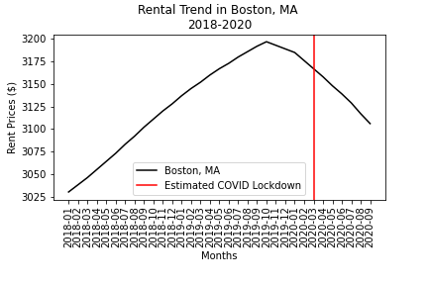
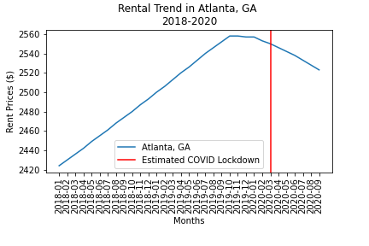
How Has the Rate of Rental Prices Changed in Metropolitan Areas Due to COVID?
Notes:
We examined rental market trends from 2018 to 2020 for Atlanta and Boston. The red line indicates COVID impact. There is an inverse relationship between the housing and rental market trends. Although the housing market grows after COVID lockdown, the rental market has a steep decline in prices uncharacteristic of the previous rental trends. We can deduce by these trend comparisons that previous renters are now purchasing homes post COVID lockdown which may be facilitated by the lower barriers of housing purchases or combining households or moving into the suburbs where homes are both more affordable and accommodating a household’s needs (schooling, bigger homes, outdoor space, tranquility, less congestion, etc).

Slide 14
Conclusion
Forbes article correlation
Prices in housing market rise with rental prices decline
Effects of millennials being at house buying age
Limitations of Data
Unclear when 2020 population snapshot was taken and could not find month over month. Also estimated population data due to low amount of census data.
Notes:
For population changes, many cities in our analysis correlated with the trends mentioned in the Forbes article. It also hasn’t even been a full year since COVID, so the data will likely look even more different 3-5 years in the future.
Overall, even though our correlation between population change rate and housing price rate was weak, prices in the housing market do continue to rise as the rental market declines during the COVID-19 pandemic.
Another interesting point that could be affecting our data is that millennials are now reaching the age where they’re starting families and in the market for houses, which could also be affecting the prices in the market.
Cities like Dallas, Miami, and Boston are expected to grow and keeping growing while other cities like Des Moines showed growth in our data but were at the bottom in the article.
Hasn’t been a full year of COVID, would be interesting to see what the data will show 3-5 years in the future

Slide 15

Questions?

